Slide 1


Mantid Scientific Steering Committee
Nick Draper
21/02/2011

Slide 2
This Release
Target Date
  25th February 2011
Major Items
  Selected by you
    Blocker – Instrument would not be able to start / process data
    Critical – Impact on some users experiments
    Major – Planned migration to Mantid would be affected, but other software could cope
    Minor – I really want this, but none of the above apply

Slide 3


Direct Inelastic - ISIS
Blocker
    Implementation of the Bleed Correction in the diag suite ( i spoke to Martyn about this and he is going to look at it)
    Overall speed improvements for the reduction
Critical
  A unified ISIS/SNS reduction stream and a unified GUI
    the current GUI is OK for startup
  Reduction capable of dealing with ISIS event mode data formats.
    essential for LET

Slide 4

Direct Inelastic - ISIS
For instrument view:
Blocker
  We need to be able to look at the sum of the counts in the individual tubes to replicate the functionality of the matlab detector test program
Major
  All the other IV things we discussed.
  Flat view unwrap point is wrong for some instruments

Slide 5
Muons - ISIS
Major
  PlotAsymmetrybyLogValue
    Allow results to be appended to previous analysis
  Musr data analysis panel
    Complete enough for basic time domain analysis in time for the startup.

Slide 6
Indirect Inelastic - ISIS
Major
  Support for ISIS & OSIRIS
    Complete the validation against MODES
  Support for TOSCA
    Validation of reduction against previous solution

Slide 7
Diffraction – ISIS
Blocker
  WISH
    Provision of a suitable 3+ dimensional workspace that supports external visualization
Critical
  PEARL
    Support for loading and applying pre-calculated absorption corrections
Minor
  POLARIS
    Support for total scattering absorption corrections

Slide 8

SANS - ISIS
Critical
  Support for Wavelength loops
  Improved Add tab support for multiperiod files
Major
  Diagnostic routines (display H, V, & time)
  SANS specific plotting & fitting
Minor
  Improved integration between UI and python scripting
  Batch mode support for multi period files

Slide 9
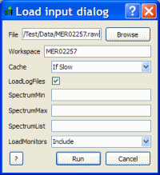
Progress over the last iteration
Installation
  No need to login to download
  Source code build is easier
    cmake
Loading data
  Users do not need to choose the matching algorithm to the data type
  Integrated with the User interface
  Also available via Python
  You can still use the specific Load algorithms if you wish

Slide 10
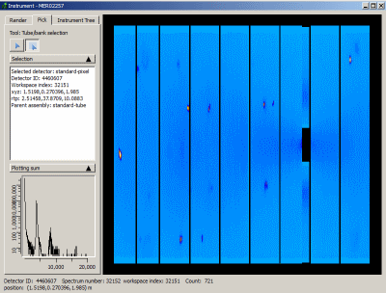
Progress over the last iteration
Instrument Display
  Picking rewrite: Two tools:
    Select Pixel
    Select Tube/Bank
  Selection details
  Sum/ integral dynamic graph
  Render tab Improvements
  The unwrapping point issue resolved.
  Cleaned out the list of colour maps
Script Window
  Recent file history

Slide 11
Progress over the last iteration
Framework
  Better Workspace memory reporting
  The default save directory is added to the data search directories
  Multi Dimensional workspaces
  Multi Dimensional centre point rebinning

Slide 12
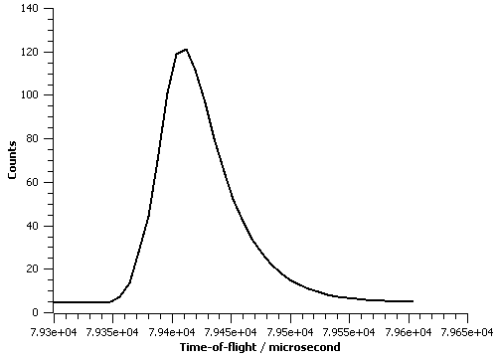
Progress over the last iteration
Model fitting and optimisation
  rewritten to support Multi Dimensional workspaces
    Previous interface retained
  Covariance matrices
    Diagonals as 100
  Ikeda-Carpenter fit function
    faster and more robust
  cost function value included in the fit parameters

Slide 13
Progress over the last iteration
Performance
  Mantid
    Geometry up to 10 times faster.
    DiffractionFocussing
      parallel processing for event workspaces.
    CheckWorkspacesMatch
      parallel and reports progress
    Event Workspaces sorting operations
      Multithreaded within a single spectra
      Great for focussed event data
  MantidPlot
    Colour fill plots are much faster
      particularly for event workspaces

Slide 14
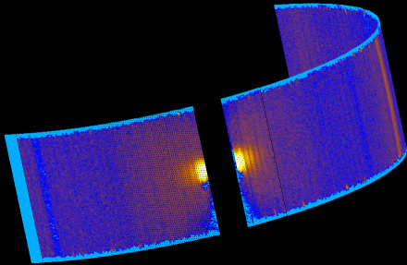
Progress over the last iteration
Event data
  Load/Save as Mantid Nexus files
    Mantid project file support
    Known Issue: These files cannot currently be loaded in Windows
  FilterBadPulses
  Reduced memory usage by the Event Workspace
  CompressEvents algorithm
    Groups events with similar X-values

Slide 15
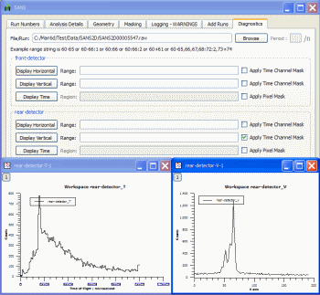
Progress over the last iteration
SANS
Diagnostics Tab
  Display Horizontal, Vertical and time plots.
Wavelength analysis
user(mask) files
  unsupported commands are reported
  A detailed help page is here
Add tab improvements:
  multi period files
  mixed raw and nexus files

Slide 16
Progress over the last iteration
HFIR SANS
  Log binning in I(Q)
  Transmission correction without dependence on theta
  Prototype reduction interface for EQSANS.
    Reduction workflow implemented

Slide 17
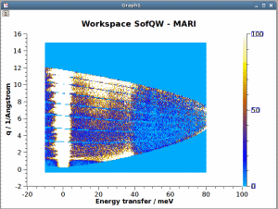
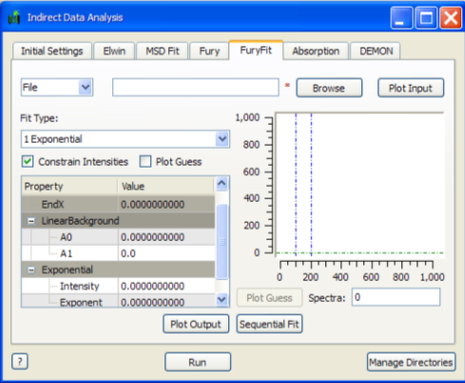
Progress over the last iteration
Direct Inelastic
  PSD bleed masking
  SofQW direct bugs have been fixed
Indirect Inelastic
  Absolute numbers validated against Modes
  A Dynamic plot has been added to the Fury tab of the Indirect Data Analysis interface.
  Tosca is now supported in the Convert To Energy Interface.
  Major rewrite of the help pages for the indirect data analysis interface

Slide 18
Progress over the last iteration
Crystallography
  SNSSingleCrystalReduction
    reduces Topaz data in Mantid for further analysis in ISAW
  Read detector calibration files created in ISAW and apply then to the instrument in Mantid
    For use on SNAP and TOPAZ.
  DSpaceMapToCal
    converts Vulcan calibration files
  PearlMCAbsorption
    loads pre calculated Absorption correction files

Slide 19
Progress over the last iteration
Muon
  Muon Nexus files (HDF4 files) can now be read on Windows 64bit
    Known issue: We have had problems with some EMU files.
  A new Plot options tab
  The Search Archive option in Manage Directories is now correctly supported within the Muon interface.
  Muon file loading has been improved
    support multiple instrument definitions

Slide 20
Progress over the last iteration
Instrument Definitions
  Better feedback for errors in instrument definitions
  New or updated instrument definitions
    Argus, INES, Loq, Maps, Sans2D, Tosca, NOMAD, TOPAZ
  New Parameter Files
    Iris, Osiris, ARCS, CNCS and SEQUOIA.
New/ Improved Algorithms
  15 new algorithms or significant improvements
Crashes/Bugs
  27 Notable bugs corrected

Slide 21
Next Release
Target Date
  6th May 2011
Major Items
  Development
    Build stability
    Performance
    Supportability
    Documentation improvements

Slide 22
Next Release
Ongoing tasks
  Framework internals
    Ability to save any workspace type
      Currently missing Table Workspaces & MD workspaces
    Improved facility support
      SNS catalog support
      Multiple catalog searching
    Support if ISIS event data
  Mantidplot
    Instrument display improvements
  SANS
    SANS specific plotting & fitting
  Muon
    Analysis interface

